Slide 1
LEVEL DESIGN WORKSHOP
PORTAL 2
GRANJON Raphaël – GD3

Slide 2
INTENTIONS – GLOBAL IDEA
EXPERIENCE
OBJECTIVE
I’ve played the first Portal from start
to finish, and I’ve watched a let’s play
for Portal 2.
I like both games a lot, however I take
my time while playing and I’m not very good at puzzle games in general.
The idea is to make a level for players who are unexperienced with the game, but can understand the puzzle with very few mechanics that don’t overwhelm the player.
Thus, I aimed for an intermediate-difficulty level.

Slide 3
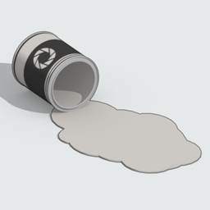
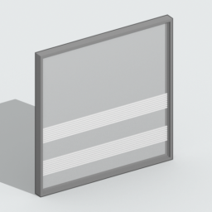
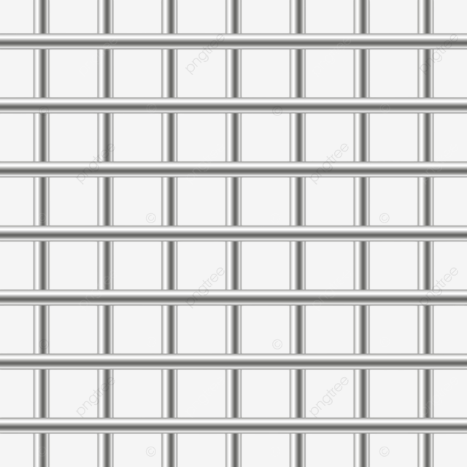
INTENTIONS – MECHANIC
White goo: Since I wanted beginners to not feel overwhelmed with
the game’s mechanics, I thought about what would make sense
to introduce right after portals. In order for portals to work, you need
to understand you can put portals on white walls, and not black walls. Thus, I decided to focus on the white goo, an extension of what
the player learns at the beginning of the game.
Grid: In addition to what walls can portals be put on, I also use the grid to introduce the notion of « What goes through, and what doesn’t », which makes this level very surface-oriented. However, I don’t want
to use the orange and blue goo as this would make the player lose focus while relying on player physics more, however I want to challenge mental skills more.

Slide 4
INTENTIONS – STRUCTURE
Following GMTK’s video « What Makes a Good Puzzle », I want my level to follow this structure:
01
02
03
04
Players find a problem right away.
They use their first assumption to solve the puzzle, but it doesn’t work.
Players then have to think outside the box to figure out a small bit of knowledge about a mechanic.
This twist is used to solve the puzzle.

Slide 5
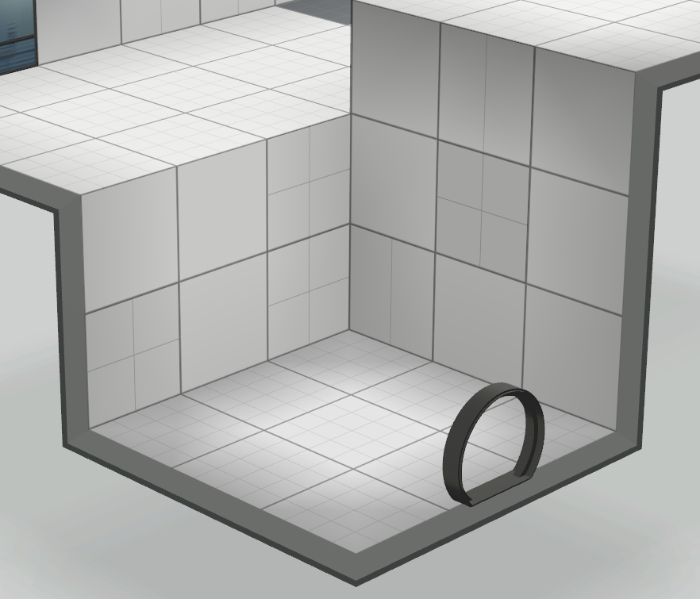
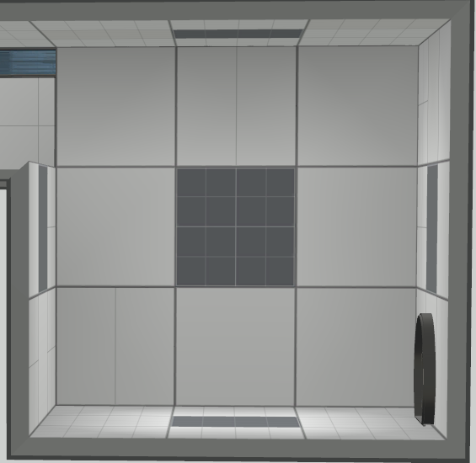
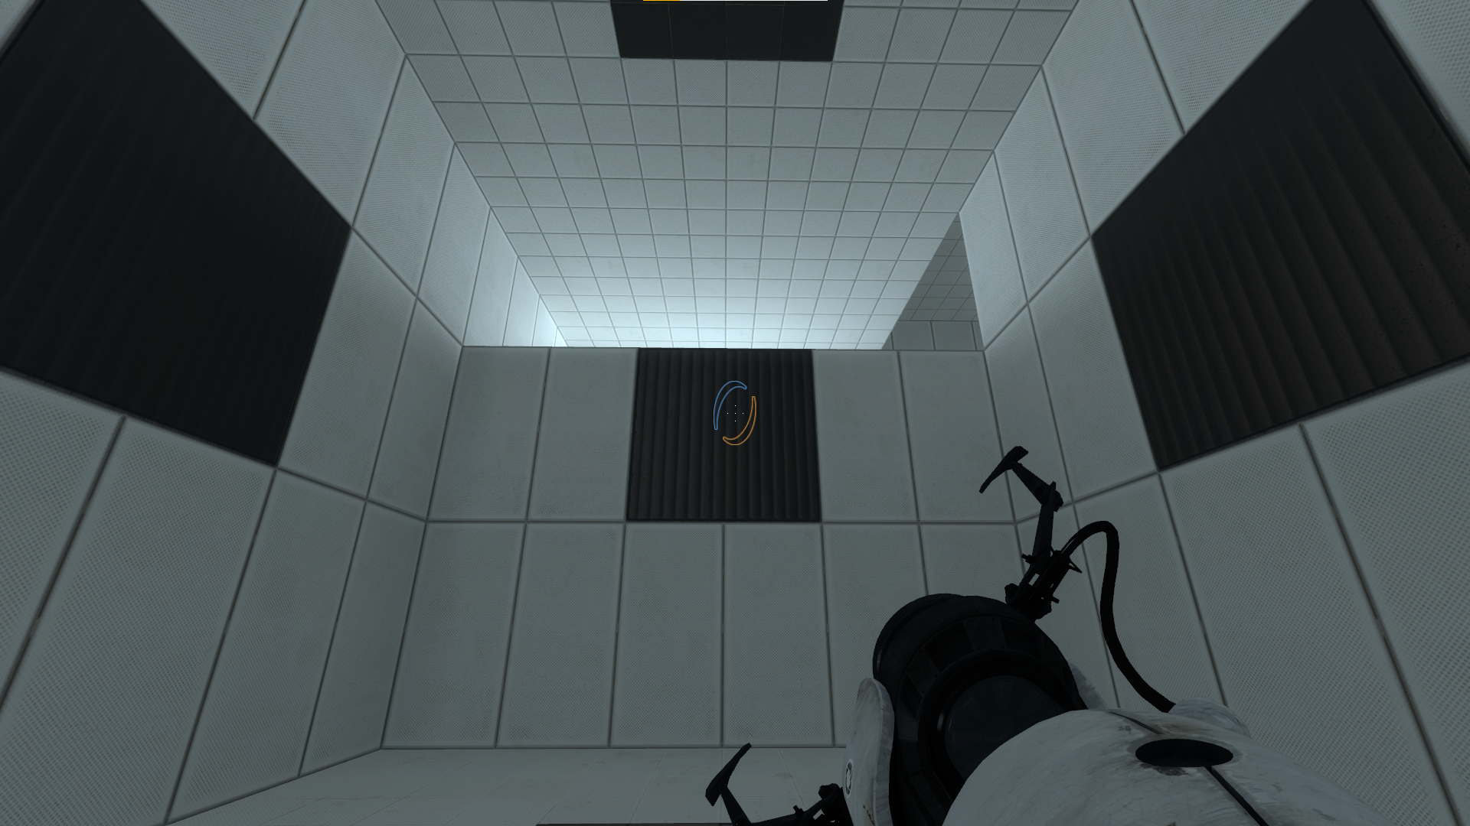
V1 - LAYOUT
V1
In order for the player to master the portals, they must know the difference between the white and black walls.
The player starts in a room full of walls
to experiment with the game’s main mechanic, as well as the basis for the upcoming mechanic that the puzzle is based on.
The player is naturally tempted to look up with
a light coming from a place higher up, that
the player needs to access by placing a portal
on the ceiling.

Slide 6
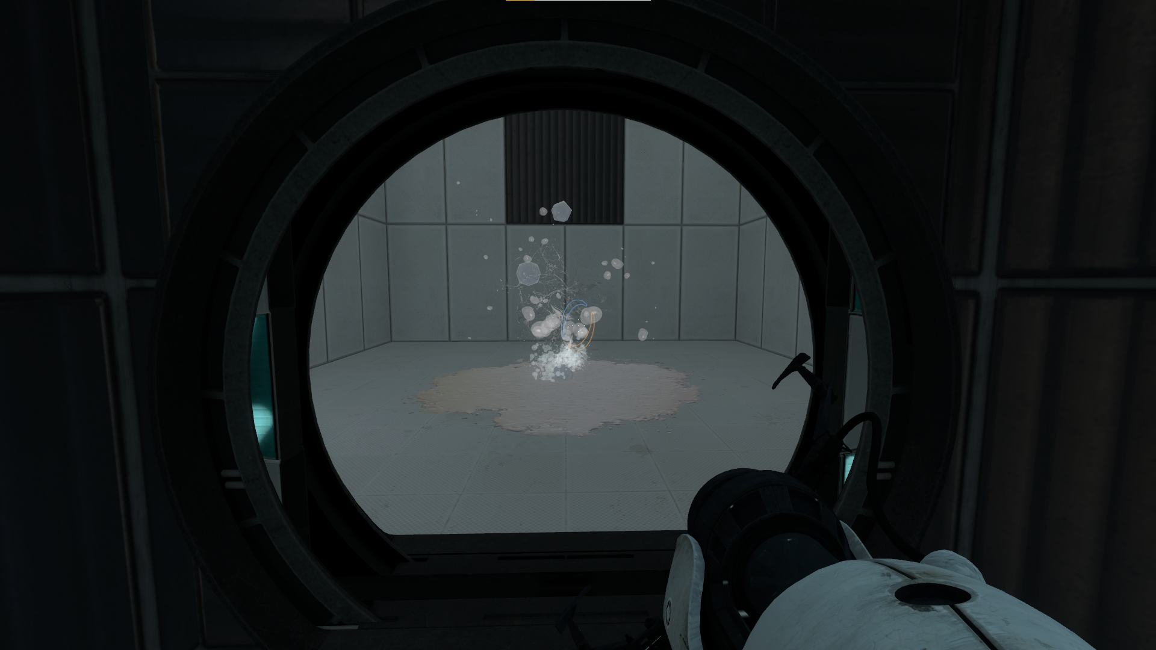
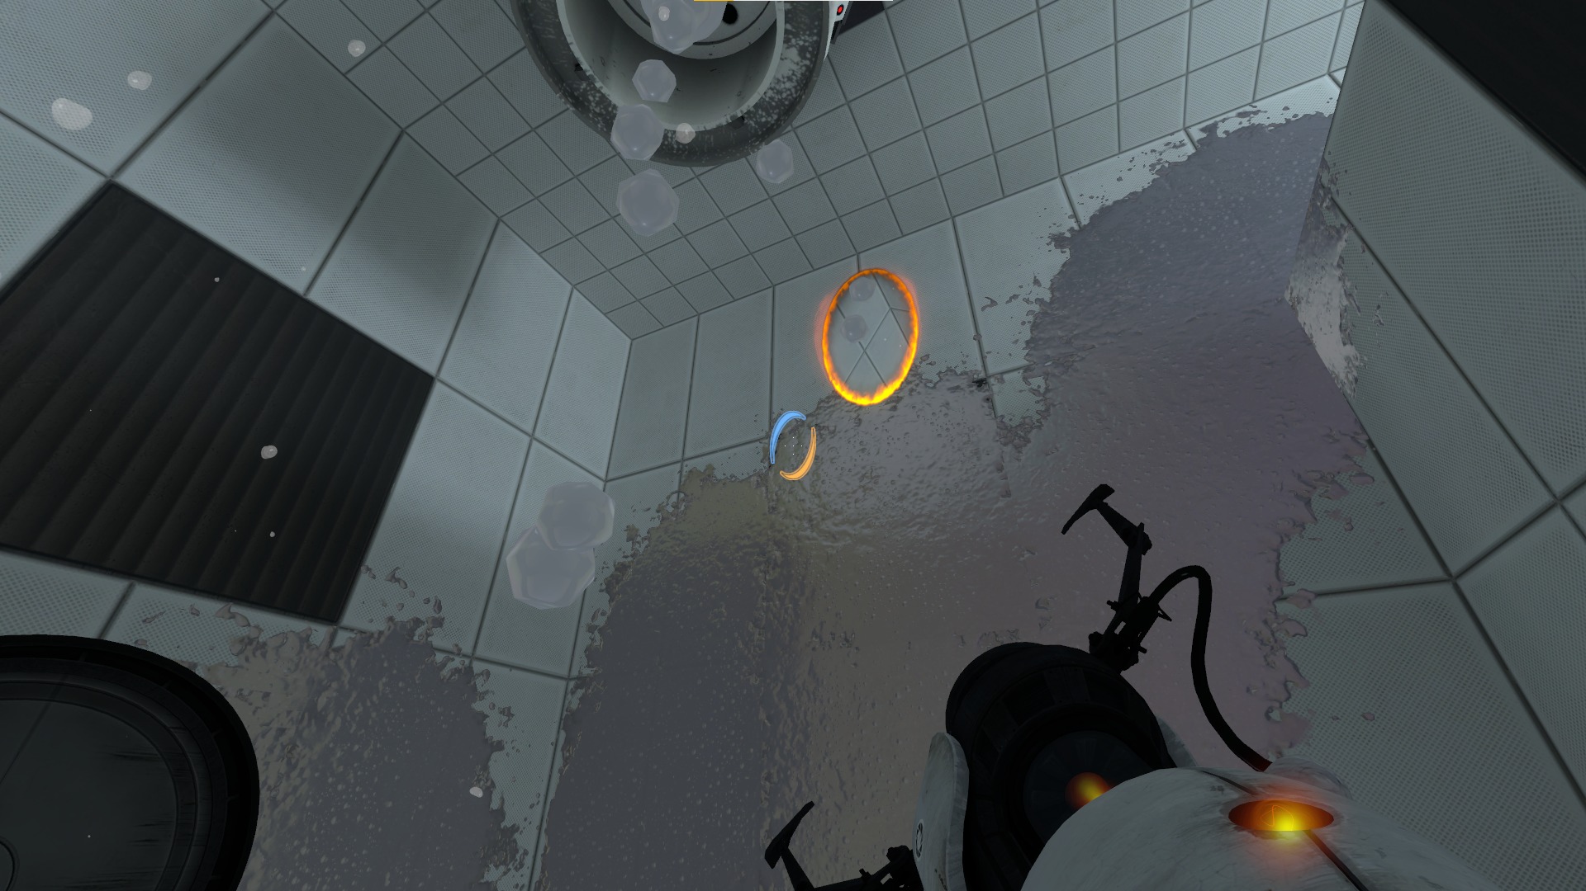
V1 - LAYOUT
V1
However, in order to make the tutorial more efficient, we can add the main mechanic right away.
By placing a white goo generator on the ceiling, making white goo fall down to the center of the room, it is the first thing the player sees when the level door opens.
The player’s view is limited in the first place, so they will want to look up. They will not only see where
to go next now, but also how the white goo appears in the level, by dropping down from a generator.

Slide 7
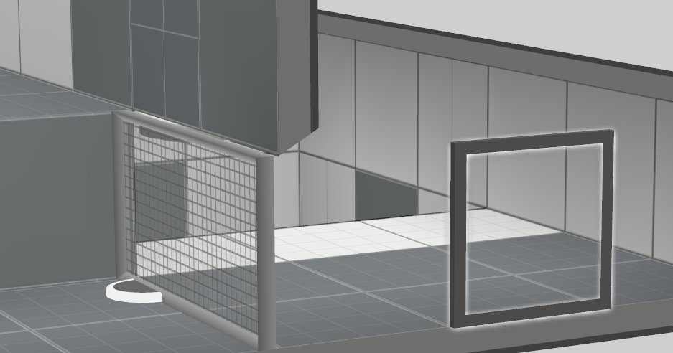
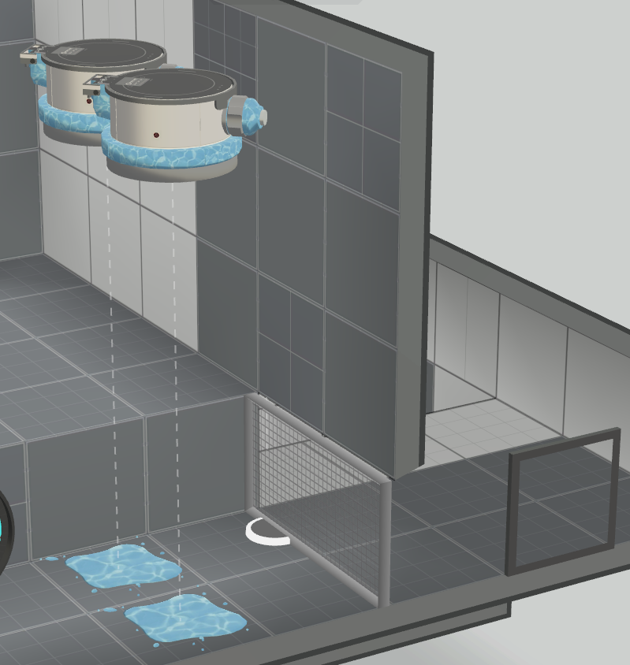
V1 - LAYOUT
V1
Once the player reaches the top part of the room,
the grid is introduced. You can shoot portals through it, however everything behind the grid is black.
This is where the player learns that white goo can
be used to change black tiles into white tiles. When the player realizes he’s blocked, he then thinks about the goo again and puts a portal on the wall, so that goo can come out of it and go through the grid, allowing you to go to the other side.
Finally, in order to teach one last thing about the goo, water is introduced so that the goo can’t go too far, showing the player it can be erased, which will
be useful for the puzzle.

Slide 8
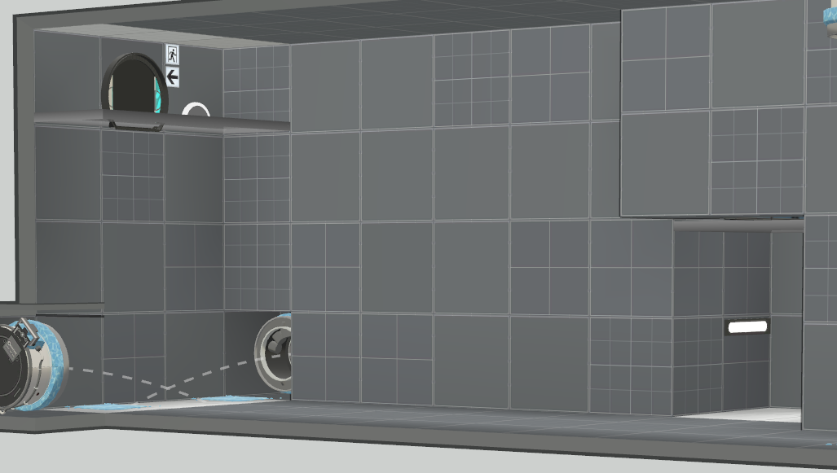
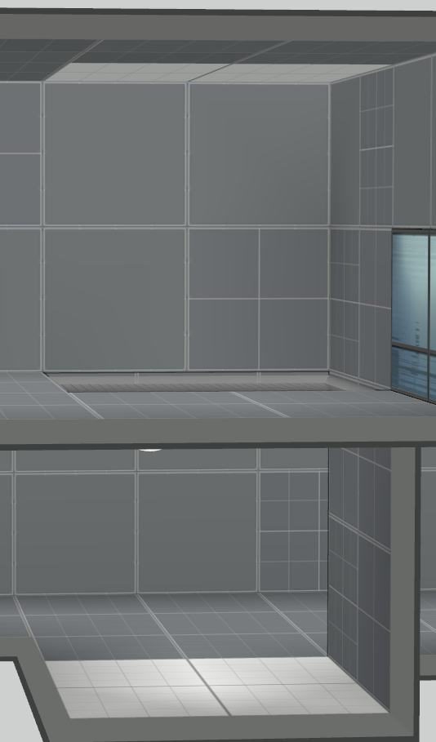
V1 - LAYOUT
V1
The player needs to go take the goo, using everything they learned so far with a white ceiling and a white ground seperated by a grid.
The assumption of the player would be to put a portal above the exit to drop goo on the ground, but
it wouldn’t work because of the water.
However, not only is there no way for the player
to think outside the box with just this layout, it can also be broken by putting a portal at the area to get the goo, and then on the ceiling.
I needed a twist to make this puzzle work.

Slide 9
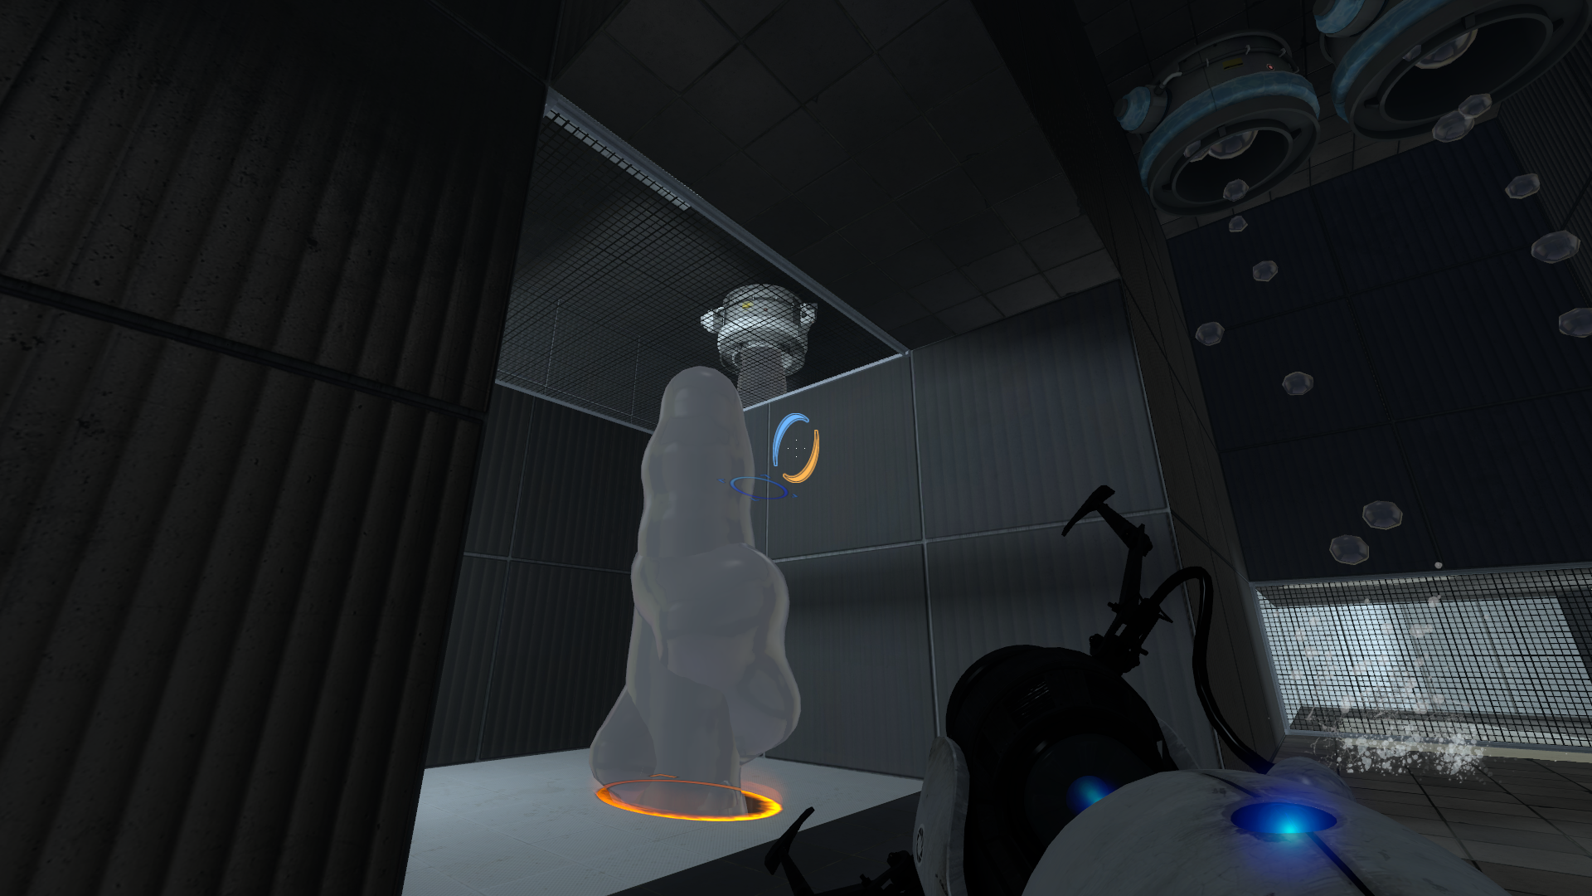
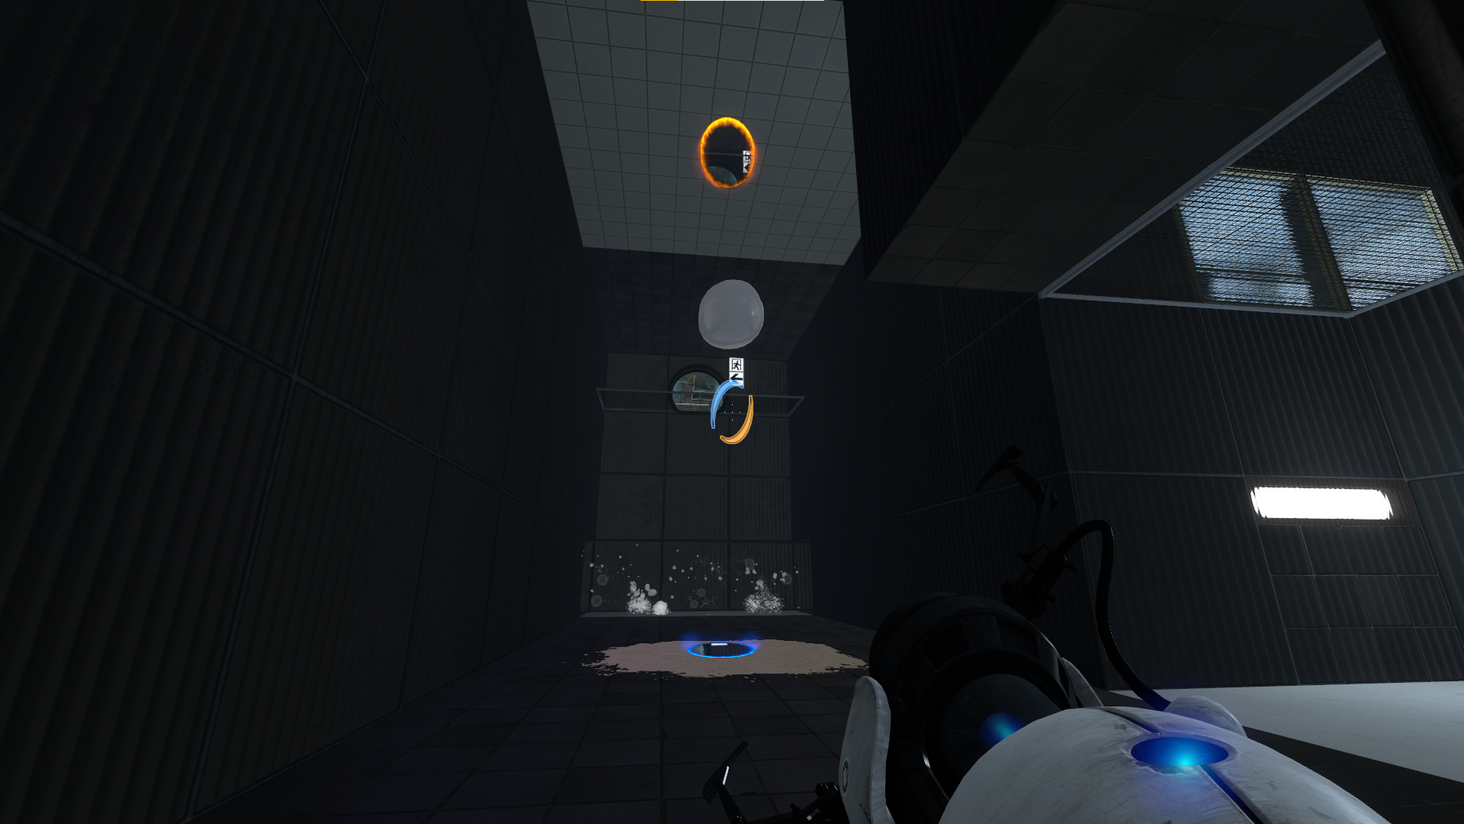
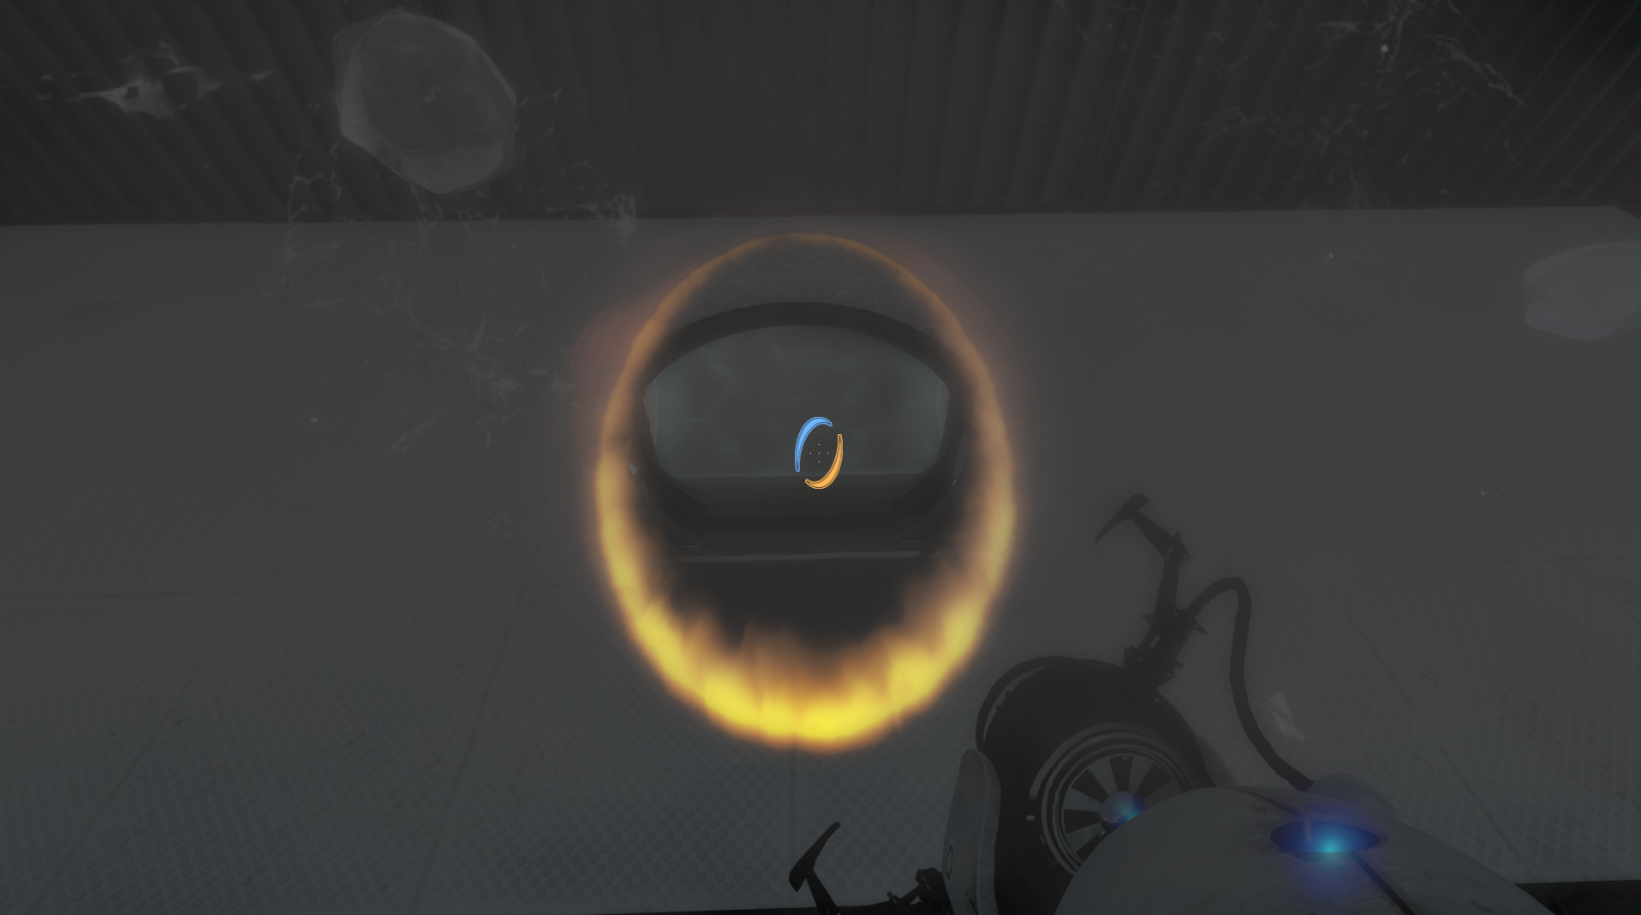
V1 - LAYOUT
V1
Turns out, the twist can come from making the goo go upwards.
Up until that point, the level shows you that goo is affected
by gravity, and falls from the top to the bottom. However, when the player gets the goo to complete the puzzle, they realize that
it can go up with portals. Removing the white ceiling above the exit and putting it on the ground, the player’s assumption would be to make it go up, but it doesn’t go high enough.
The player then finds another white ceiling, which then creates
a white ground with the goo dropping from above. You can then trap the goo with two portals to make it go faster, which
is the twist. Then put a portal below the exit to make the goo
go up in a splash and complete the puzzle.

Slide 10
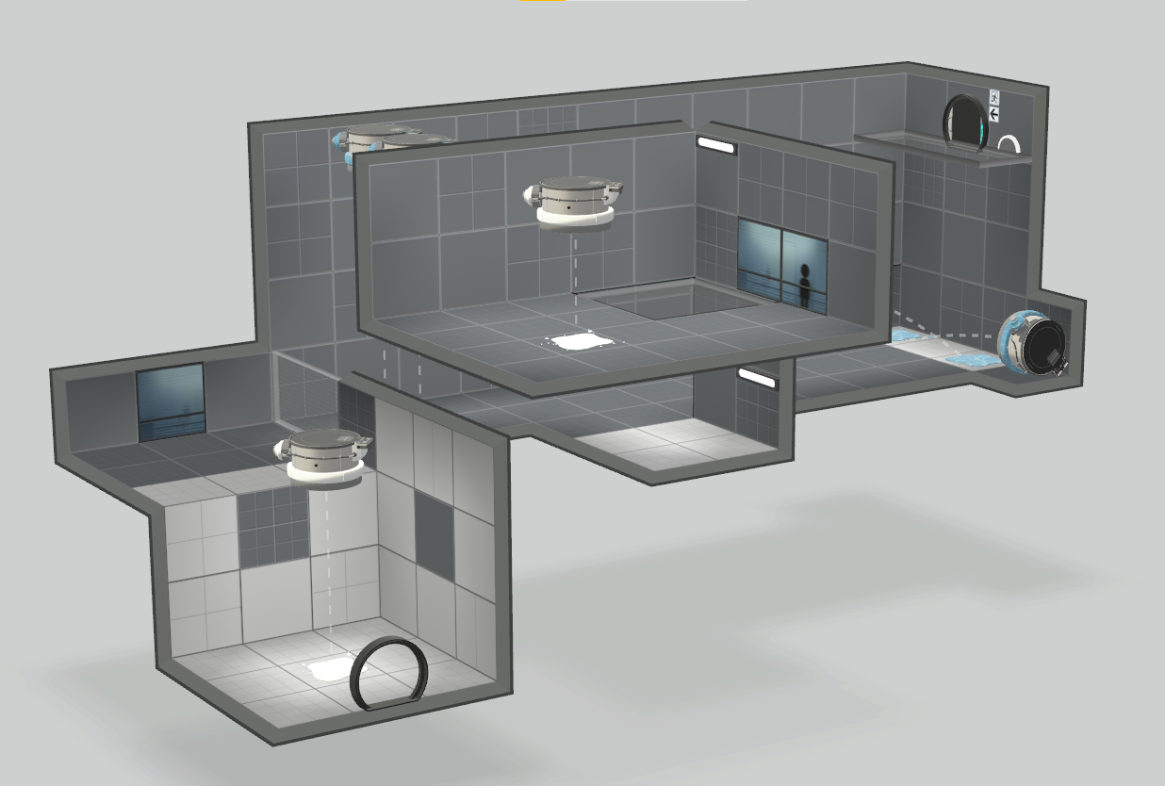
V1 - LAYOUT
Here is the entire V1 layout:
V1

Slide 11
V1 - FEEDBACK
V1
I did two playest sessions: one with experienced players, and one with my target audience: beginners.
Experienced players showed the puzzle actually had some depth to it, as even to a Portal player moving the goo through the portal using physics instead of the player’s character is thinking outside of the box.
Water is naturally a bit disturbing, as it doesn’t have any use to the puzzle anymore, however it can help limit player experimentation from going too far.
Beginners lack guiding in general as there isn’t enough lighting. They also think at first that water is the same as white goo.
The biggest problem is that the starting area doesn’t require them to use the white goo, and they instead confuse themselves by messing around with the portals.

Slide 12
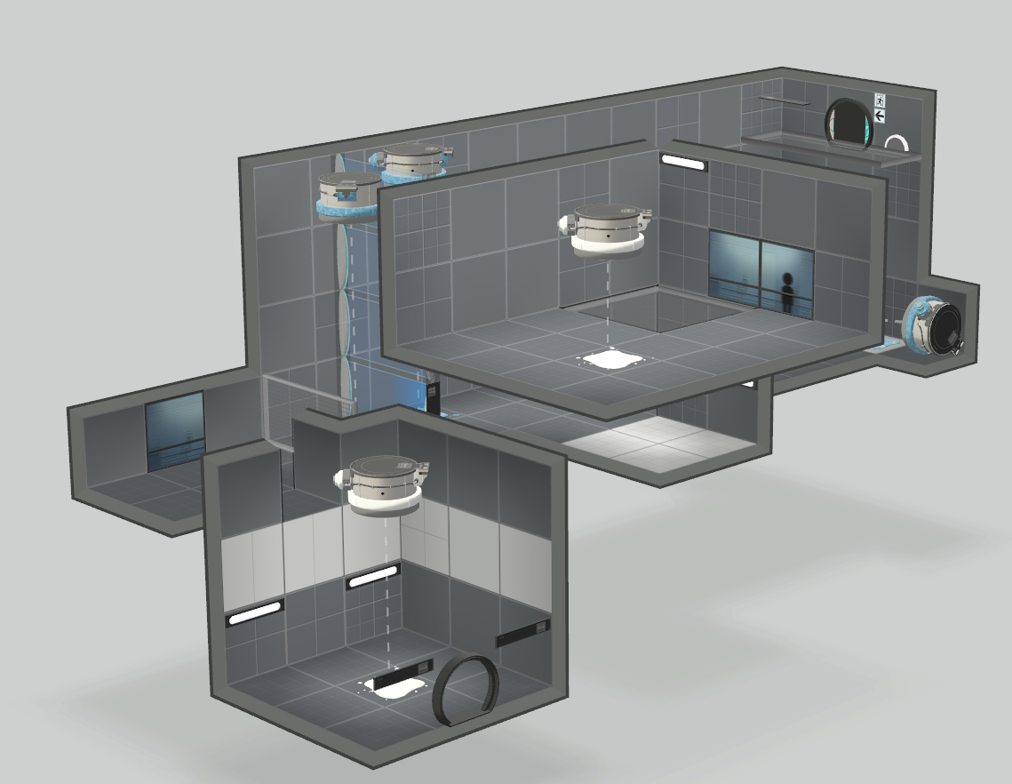
V2 - LAYOUT
With this feedback taken into consideration, here’s the V2 layout:
V1
V2

Slide 13
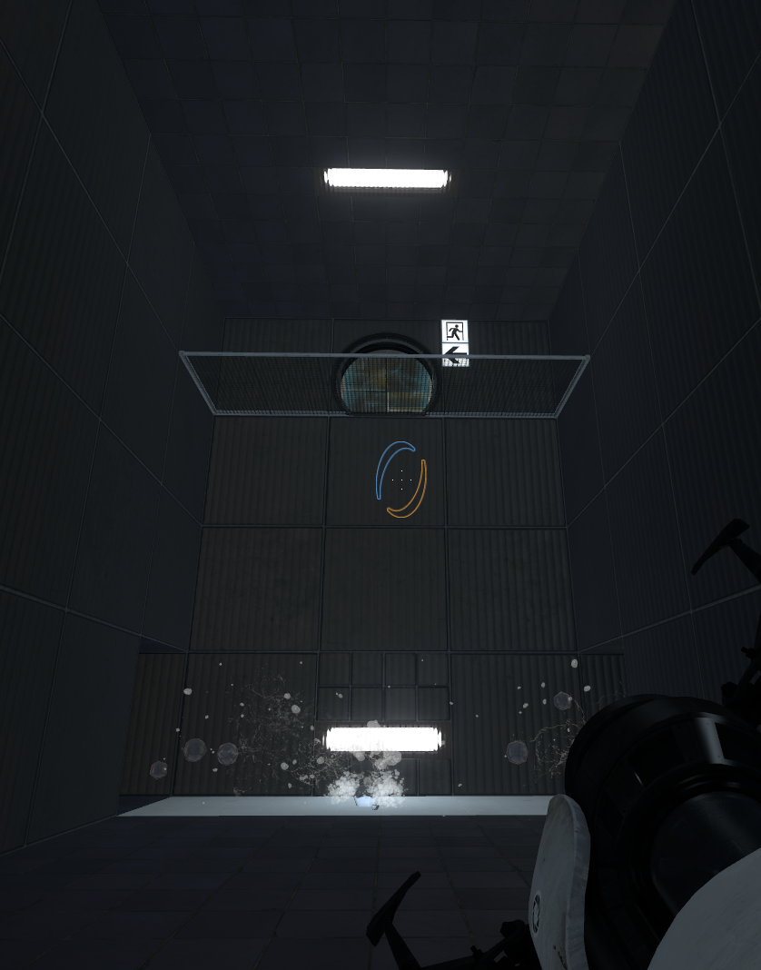
V2 - UPDATE
The starting area has a lot more black walls so that players have to use the goo to put a portal and get upstairs, which also makes it so that the twist of making the goo go up isn’t spoiled right away.
The two water generators are seperated in order to show the clear distinction between paint interacting and water and goo sticking on the ground. Barriers were added to not cheat and only use goo to access the main area.
V1
More lights were added in order to further guide the player towards the solution.
V2

Slide 14
V2 - FEEDBACK
V1
Since changes were made related to accessibility and mechanic introduction, I did a playtest session with my core audience.
Turns out, the remaining white walls make the portal mechanic still confusing at first because the player can’t directly interact with them. Moreover, by making paint come out of the walls they do not need to go the next room while understanding how to use goo with the portals.
The lights being near the white walls there’s not enough light to understand that the white goo is also white and functions the same as the walls when it comes to portals.
It is still hard to put goo through the grid before the main area, and water is still not considered as water at first.
The wall setup to not access the main room through portals when you’re behind the grid is confusing for new players, thinking it’s a straight-up wall and this is not where you should go.
V2

Slide 15
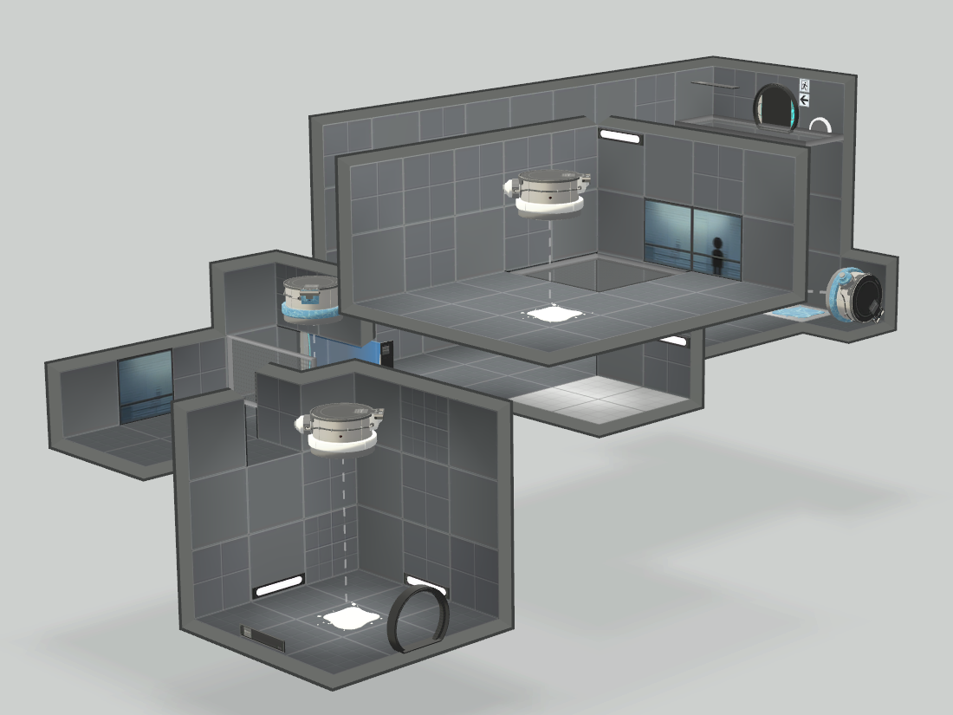
V3 - LAYOUT
With this feedback taken into consideration, here’s the V3 layout:
V1
V2
V3

Slide 16
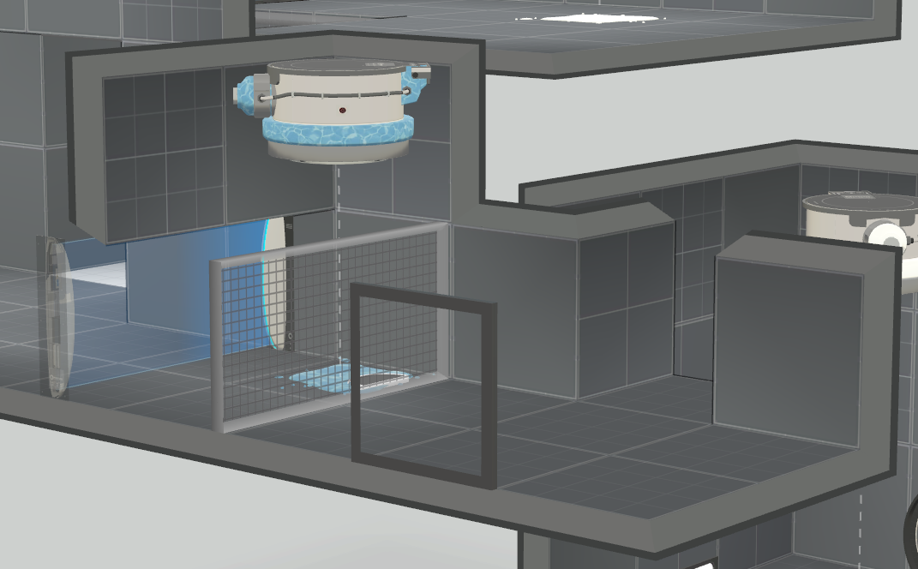
V3 - UPDATE
All white walls have been removed from the starting area so the player is required to use the goo to go up. The lights have been moved to the ground, surrounding the paint to make it obvious.
The wall is not as tall as before so that when players enter the main room, they don’t look back at a giant blue wall trying to figure out if it has its use in the puzzle.
The second water generator has been removed, and the first one drops water as bombs and not as a constant drop like for the white goo earlier, which sets them apart visually and teases the white goo bomb of the main area.
V1
V2
V3

Slide 17
V3 - FEEDBACK
V1
I started to understand that the level was indeed not quite suited for beginners, so I went back to a playtest session with more experienced players.
If you fail the timing of the looping white goo ball, it explodes and you have to get it again, which is tedious for some players despite it not being far away from the player’s location.
This was mentionned by both experienced players and beginners, this thus needs to be adressed.
Finally, water is still not clear in its use, players who have the solution to complete the puzzle think they cannot put the portal where the water shoots out, even though they can as it doesn’t affect the white ground.
Since it doesn’t technically have a use in the puzzle’s resolution, water gives players more questions than answers.
V2
V3

Slide 18
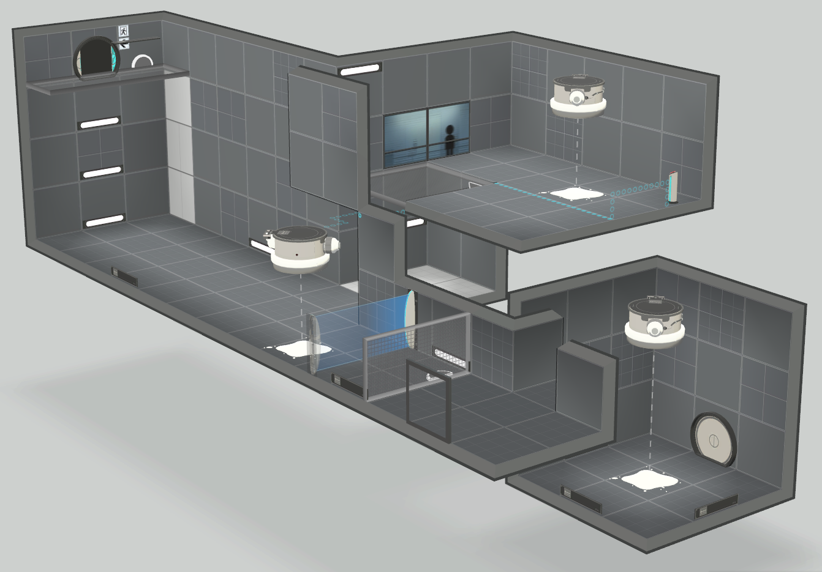
V4 (FINAL) - LAYOUT
With this feedback taken into consideration, here’s the final layout:
V1
V2
V3
V4

Slide 19
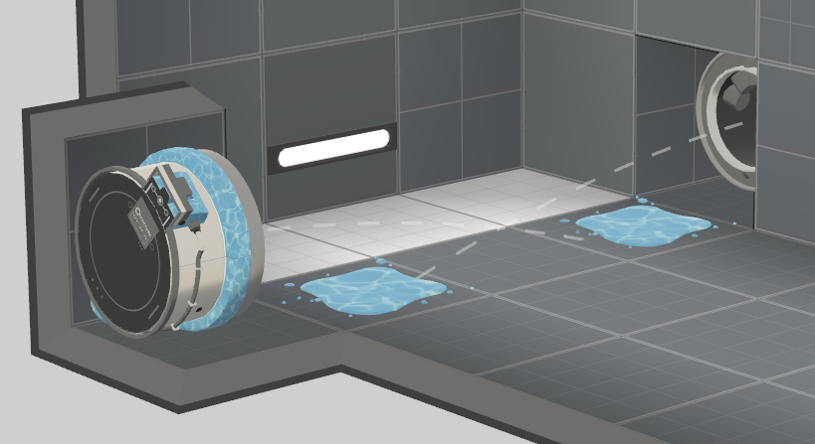
V4 (FINAL) - UPDATE
The water was straight up removed to avoid any confusion regarding the puzzle’s solution as well as easing access to the main room further.
The ground isn’t white anymore. Instead, you use the side walls to put goo on the ground first, and then use it later to shoot the goo to the ceiling. It adds an extra step that is easier to do than the loop part to smooth the progression, as well as making the player acknowledge the solution even more.
To make getting the goo back once you got it the first time less frustrating, while not breaking the puzzle steps, a button on the upper floor activates another goo generator on the base floor. This way the player is still being teased the goo going upwards while removing a lot of frustration from failing the white goo ball loop.
V1
V2
V3
V4

Slide 20


CONCLUSION
I had lots of fun coming up with a puzzle with a clear goal, and while I think the final is level is good, some elements aren’t exactly respecting my original intentions.
What went WELL
What went WRONG
The use of very few mechanics led to a simple yet interesting level.
I was able to follow a structure where players can try out different theories and find the solution to the puzzle with a twist that surprises them.
I couldn’t iterate fast enough especially as I couldn’t find a lot of beginners who were willing to try the level. Ultimately, I couldn’t appeal to people who had never played the game before.
Water was removed way too late in the process, it could have been removed the moment I found the twist.

Slide 21
THANKS!

